Slide 1
Nail Salon Management System
Deliverable 5: User Interface Design, Program design and System Implementation
Salman Khan, Thomas Zhang, Spencer Wilkins, Derek Luong, Asad Khan, Hamza Mir

Slide 2
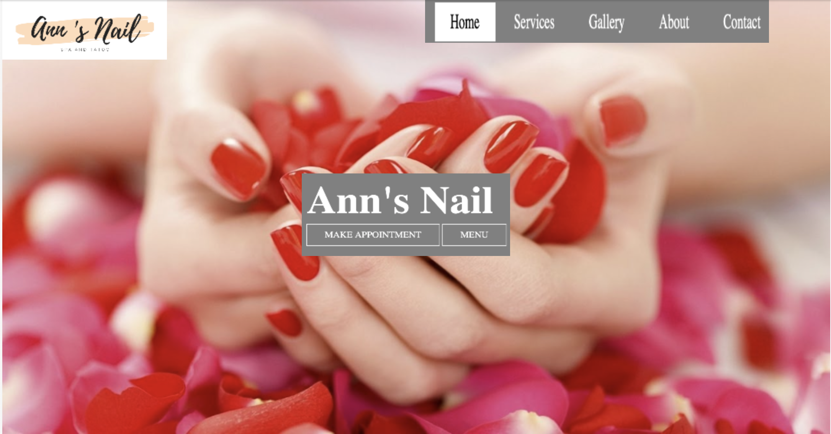
Prototype

Slide 3
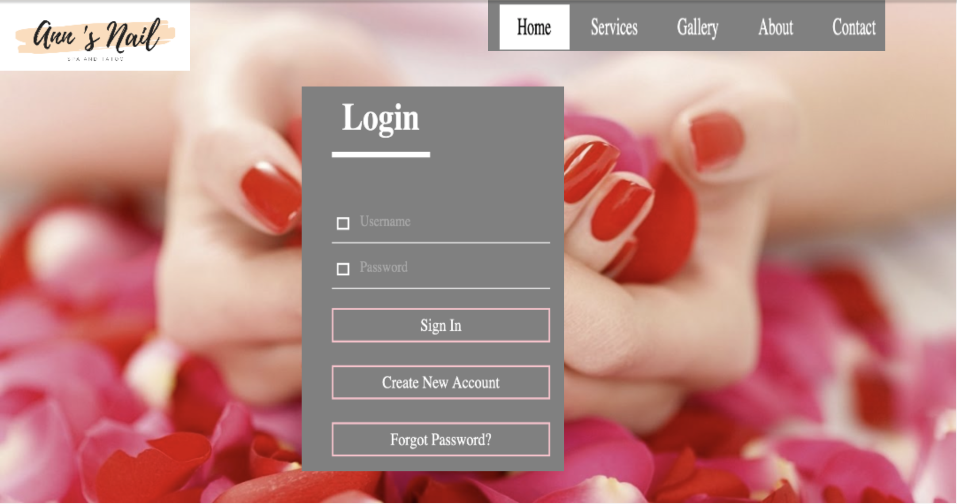
Prototype

Slide 4
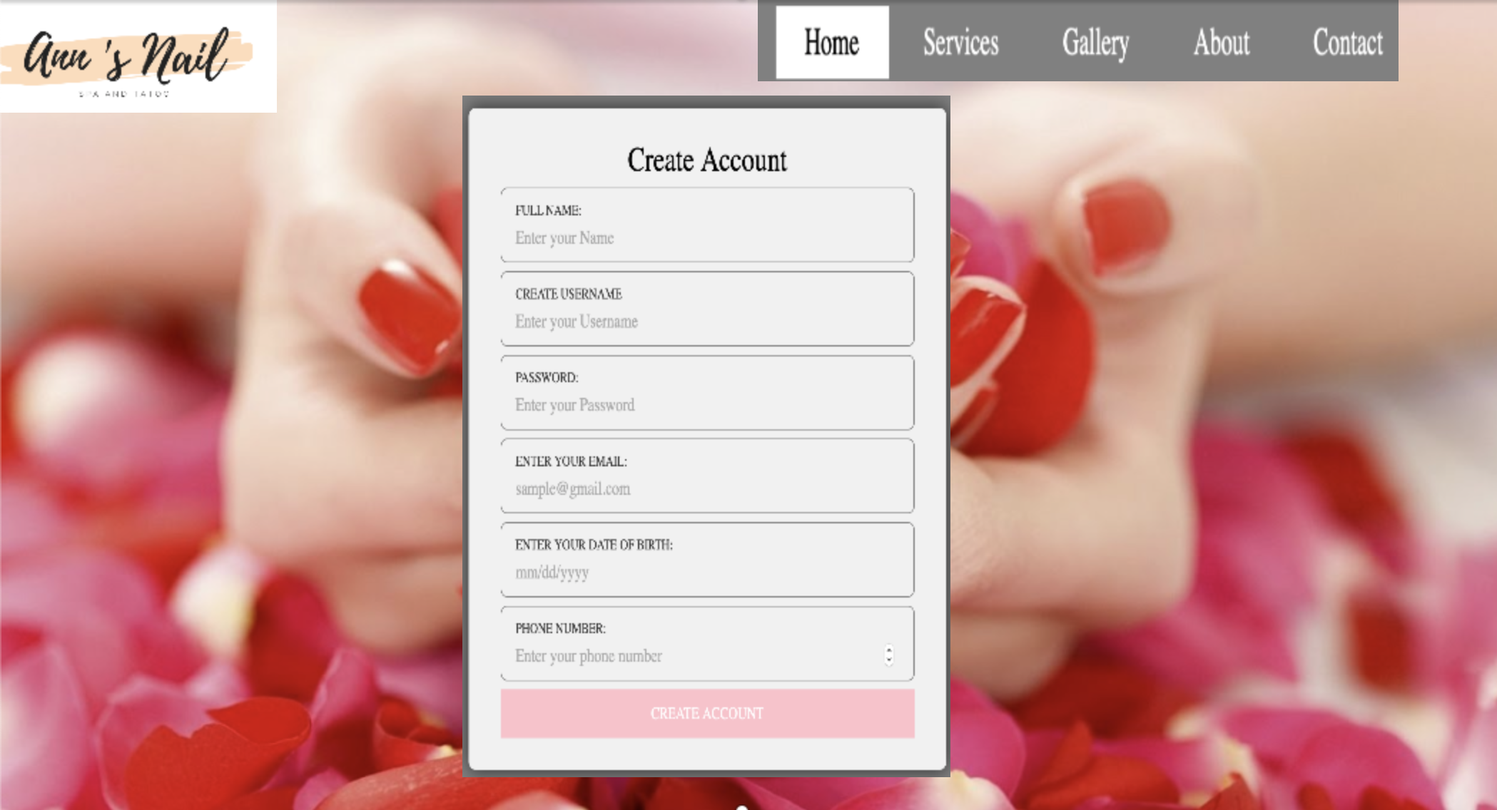
Prototype

Slide 5
Functional Requirements
Allows customer to create account, if account already exists then the customer will get a notification
Customer is able to view information about business on website such as opening/closing time and once logged in is able to schedule appointments by looking for open times on calendar
Customer is able to check or request information for their account such as appointments made and appointment time.
Employees are able to see open times and times reserved by customers

Slide 6
Systems Requirements
HW/SW:
HTMl, CSS, Javascript, PHP
Visual Studio
AWS Cloud Service
System Procedures
Customer account creation, account inquiry, scheduling will be done on company website.
Data will be stored on amazon web service, cloud storage will be purchases based on the number of accounts created.

Slide 7
SDLC - Challenges
Scheduling Differences:
Problems with finding consistent times to meet and complete project. Overcame by working and communicating using GroupMe and text so once people saw the updates, they could then take care of their tasks and provide updates. Also maintaining Google Docs / Google drive so people could access it wherever and whenever.
Changing Scope of Project:
Project scope changed after every deliverable, could not come up with one idea and how to do tasks. Worked in small teams and shifted people to help one another and keep each other abreast of the changing developments and up to date on changes and implications. Changed project design, was too difficult initially, limited to 4 use cases.

Slide 8
SDLC - Benefits
Specialization:
Having different strengths and assigning work based on the strengths of the group members and moving from part to part kept things fresh/current.
Focus:
Moving along the plan it kept us focused on the task on hand, the changes we had to make, working on what was due next.

Slide 9
SDLC
Overall experience was great for everyone because at first our communication was not strong because we were not familiar with one another. We did not know what was expected of us and how we were going to approach the goal we were going for. However as the project went on we were getting to know each other more and were able to work together strongly and make better decisions as a team.

Slide 10
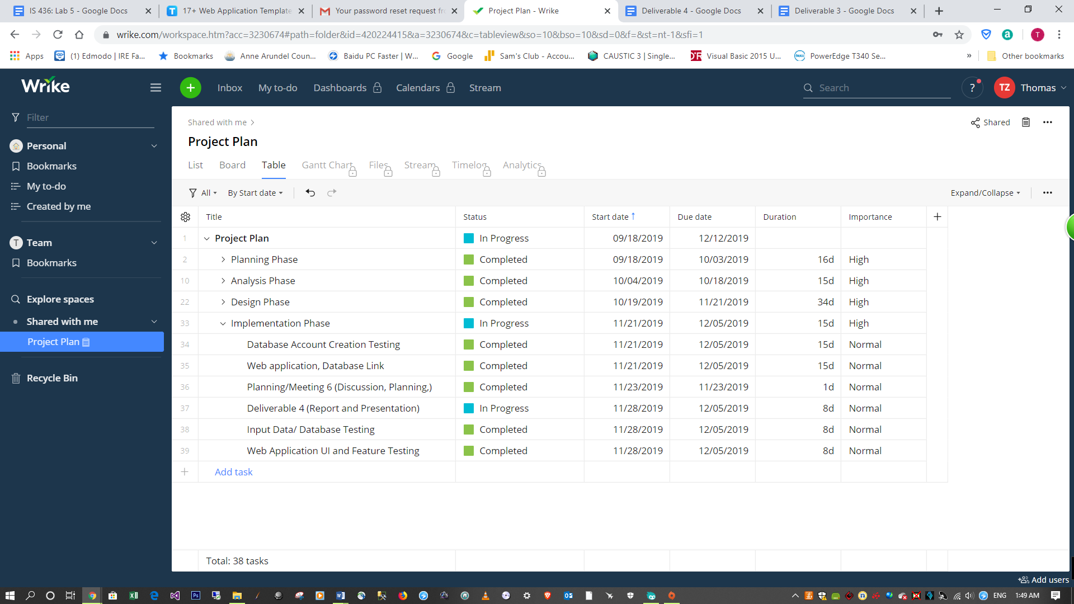
Project Plan

Slide 11
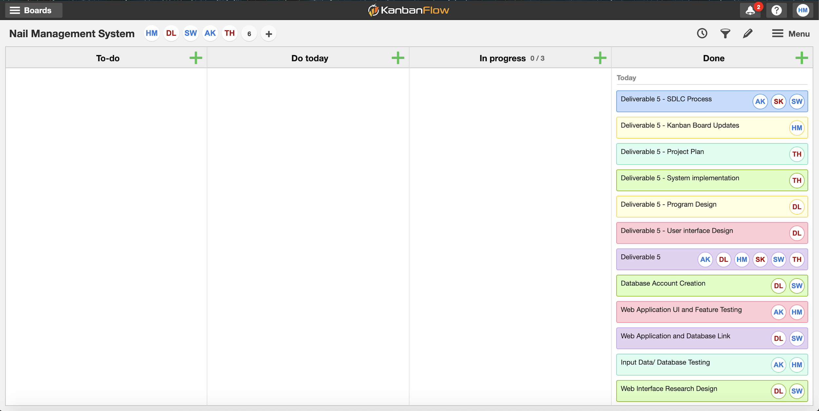
Kanban Board

